Slide 1
Cybersecurity Assessment Project
Debian Server Security Evaluation
Internal Host-Only Lab Environment

Slide 2
Project Overview
Objective: Identify and remediate system vulnerabilities
Environment: Host-Only Network (192.168.56.0/24)
Attacker Machine: Kali Linux
Target Machine: Debian Server

Slide 3
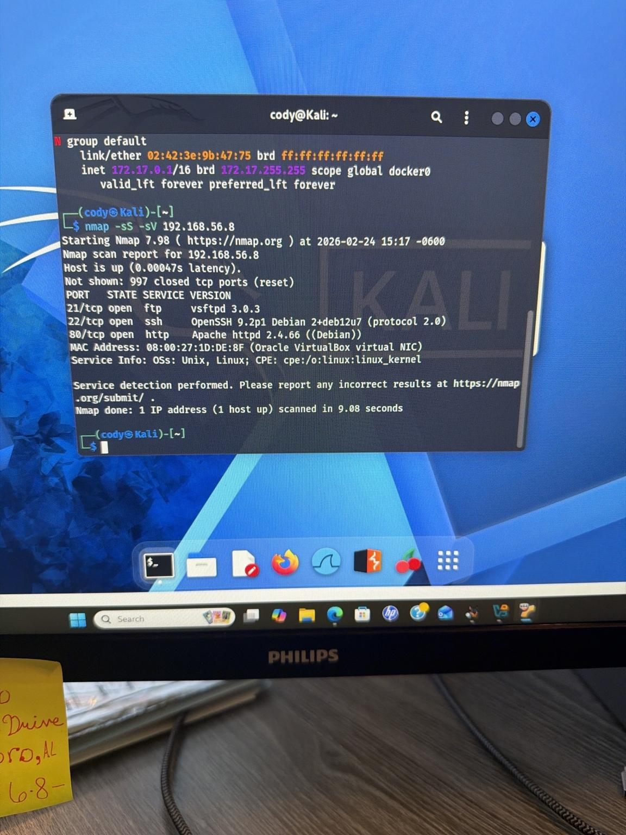
Vulnerabilities Identified
Port 21 (FTP) – Anonymous login enabled
Port 80 (HTTP) – Apache exposed
Port 22 (SSH) – Open remote access
Misconfiguration increased attack surface

Slide 4
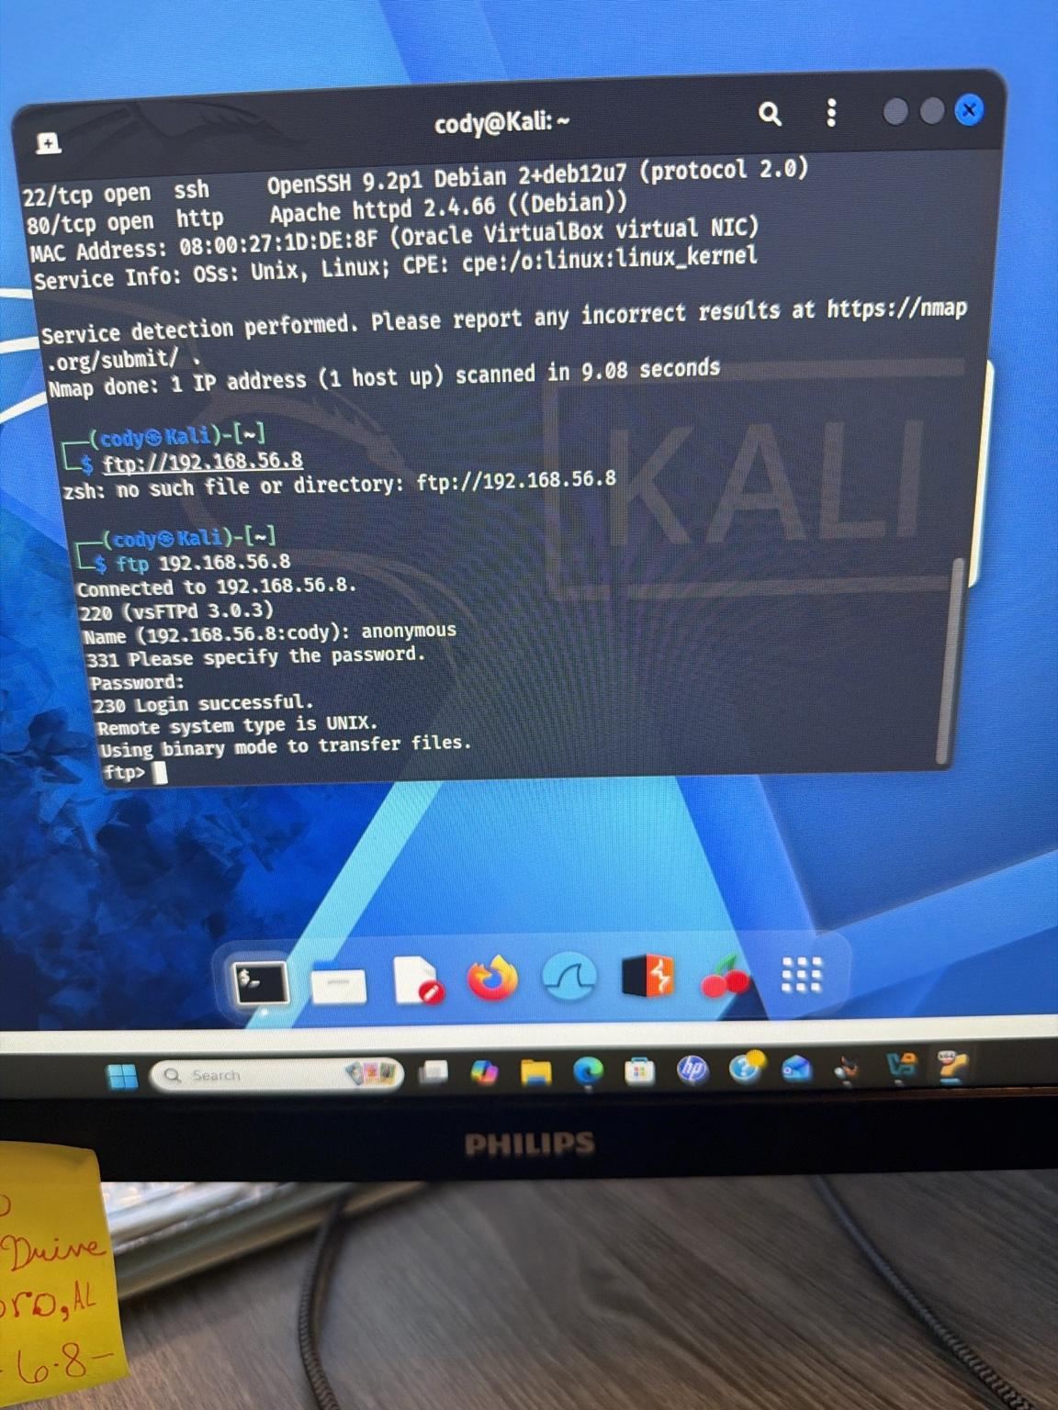
Exploitation Summary
Performed Nmap scan to identify open services
Successfully authenticated using anonymous FTP
Enumerated directory contents
Confirmed exposure risk

Slide 5

Remediation Actions Taken
Disabled anonymous FTP (anonymous_enable=NO)
Restarted vsftpd service
Installed and enabled UFW firewall
Blocked port 80 using firewall rules

Slide 6
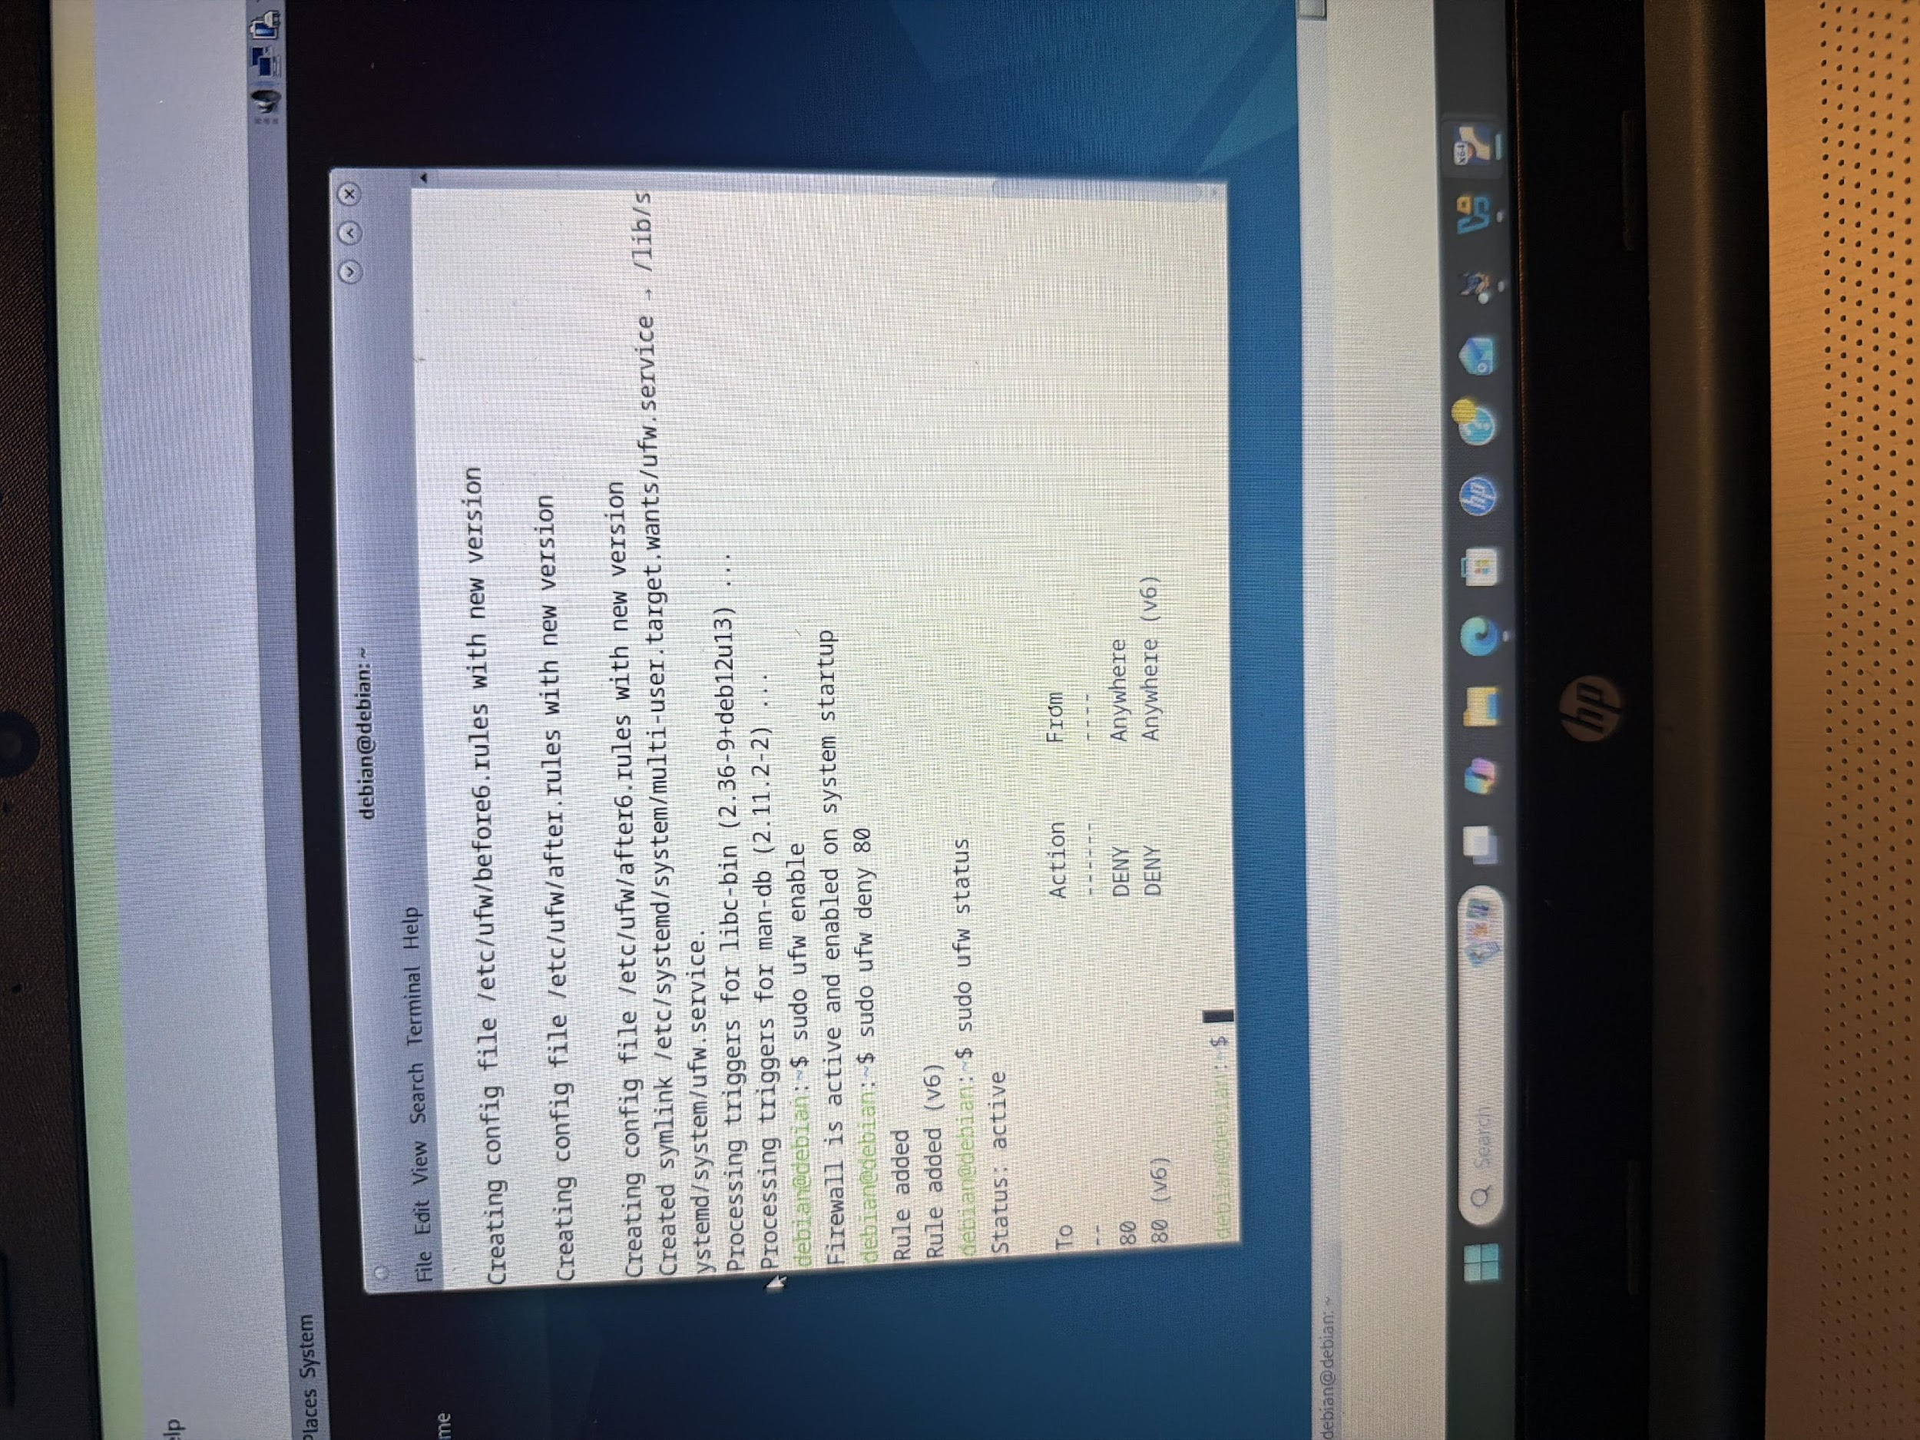
Verification & Hardening
Post-remediation Nmap scan performed
Port 80 confirmed filtered/blocked
Anonymous FTP access denied
Reduced overall attack surface

Slide 7
Incident Response & ISMS Implementation
Aligned with NIST SP 800-61 framework
Developed formal Incident Response Plan
Implemented ISO 27001-based ISMS structure
Established continuous improvement process

Slide 8
Recovery & Business Continuity Plan
Defined Recovery Time & Recovery Point Objectives
Implemented backup strategy
Documented restoration procedures
Established stakeholder communication plan

Slide 9
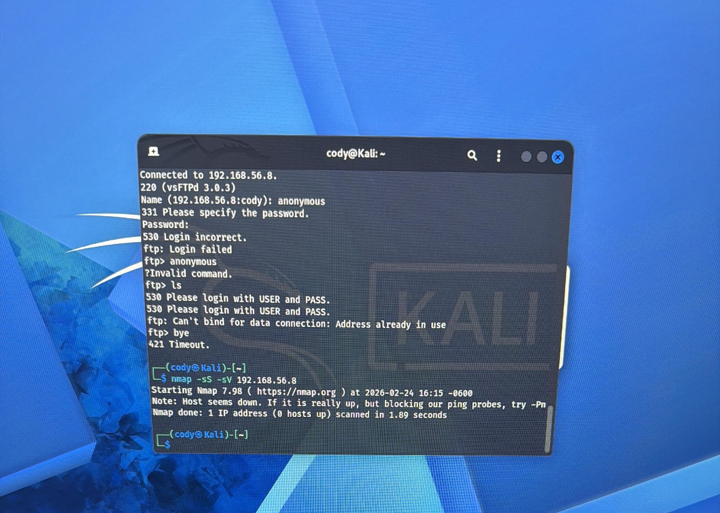
Final Security Posture
Anonymous FTP eliminated
Port 80 secured via firewall
Services hardened and verified
Ongoing monitoring recommended

